Slide 1
Lesson objective
PBiS Focus
Respect (listening)
Learn (Participation)
Title: Simplifying ratios
Aim:
Reduce a ratio to its simplest form
Able to divide a quantity into two or more parts in a given ratio
Need whiteboards and calculators

Slide 2



Where are you now?
I know quite a bit about ratio
I’ve seen or heard of ratio before
Not sure what ratio is

Slide 3
Intro
Learning Objectives
To be able to simplify ratios
To be able to divide an amount by a given ratio
A ratio compares values. It says how much of one thing there is compared to another thing.
1 to 3
1 : 3

Slide 4


Ratios compare the size of different things against each other
Cordial : Water
1 : 4
Red : Green
5 : 3
Green : Yellow
3 : 7
Say
“Cordial to water”
“One to four”
Say
“Red to green”
“Five to three”
Say
“Green to yellow”
“Three to seven”
Always write column headings
Always line up the colons
Every time
No excuses!

Slide 5
Defining factors
A number or quantity that multiplies to produce another number.
E.g. 4 x 5 = 20
4 and 5 are factors of 20.
Can you think of other factors for 20?
THINK: What numbers also fit evenly into 20?

Slide 6
Simplifying Ratios
Learning Objectives
To be able to simplify ratios
To be able to divide an amount by a given ratio
Ratios can be simplified by dividing each part by the highest common factor.
e.g. 7 : 21
So 1 : 3
7 is the highest common factor

Slide 7
Simplifying Ratios
Learning Objectives
To be able to simplify ratios
To be able to divide an amount by a given ratio
Remember that units are important as is order.
e.g. 30mm : 4cm We need to convert so both sides are in the same unit, so
30mm : 40mm

Slide 8
I do
THINK: what number goes into both numbers?
Simplify
10 : 5
32 : 8
14 : 7

Slide 9
We do
THINK: what number goes into both numbers?
Simplify
15 : 5
9 : 3
18 : 2

Slide 10
You do – Whiteboards
THINK: what number goes into both numbers?
Simplify
12 : 6
4 : 12
9 : 3
25: 15

Slide 11
How did you do?
All or almost all answers correct
Most answers correct, some errors
Majority of answers incorrect

Slide 12
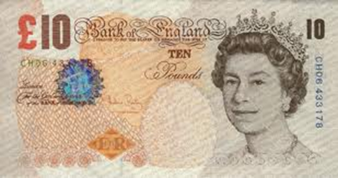
Dividing by a ratio
Learning Objectives
To be able to simplify ratios
To be able to divide an amount by a given ratio
Often we might need to divide an amount by a ratio.
e.g. Divide £50 into the ratio 2 : 3
There are some common steps to allow us to work this out

Slide 13
Dividing by a ratio
Learning Objectives
To be able to simplify ratios
To be able to divide an amount by a given ratio
Steps to Success
Add together the total number of parts of the ratio
Divide the given amount by the total number of parts
Multiply the answer by each ratio amount
Check that your answers add up to the same total given in the question

Slide 14
Dividing by a ratio
Learning Objectives
To be able to simplify ratios
To be able to divide an amount by a given ratio
Divide £50 into the ratio 2 : 3
Add together the total number of parts of the ratio
Divide the given amount by the total number of parts
Multiply the answer by each ratio amount
Check that your answers add up to the same total given in the question
(2 + 3 = 5)
(50 ÷ 5 = 10)
(10 x 2 = 20 and 10 x 3 = 30)
(20 + 30 = 50 ✓)

Slide 15
I do
Add together the total number of parts of the ratio
Divide the given amount by the total number of parts
Multiply the answer by each ratio amount
Check that your answers add up to the same total given in the question
Share 100 in the ratio of 4 : 6
Share 36 in the ratio of 4 : 5
Share 44 in the ratio 9 : 2

Slide 16
We do
Add together the total number of parts of the ratio
Divide the given amount by the total number of parts
Multiply the answer by each ratio amount
Check that your answers add up to the same total given in the question
Share 99 in the ratio of 5 : 6
Share 21 in the ratio of 1 : 2
Share 24 in the ratio 4 : 3 : 1

Slide 17
Whiteboards
Share 20 into the ratio 2 : 8
Share 40 into the ratio 5 : 3
Share 25 into the ratio 2 : 3

Slide 18
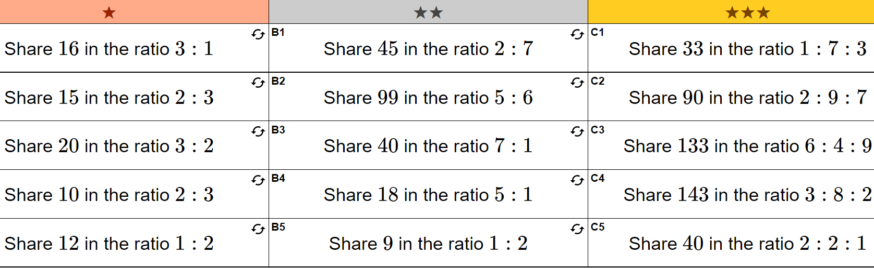
You do – exercise books

Slide 19
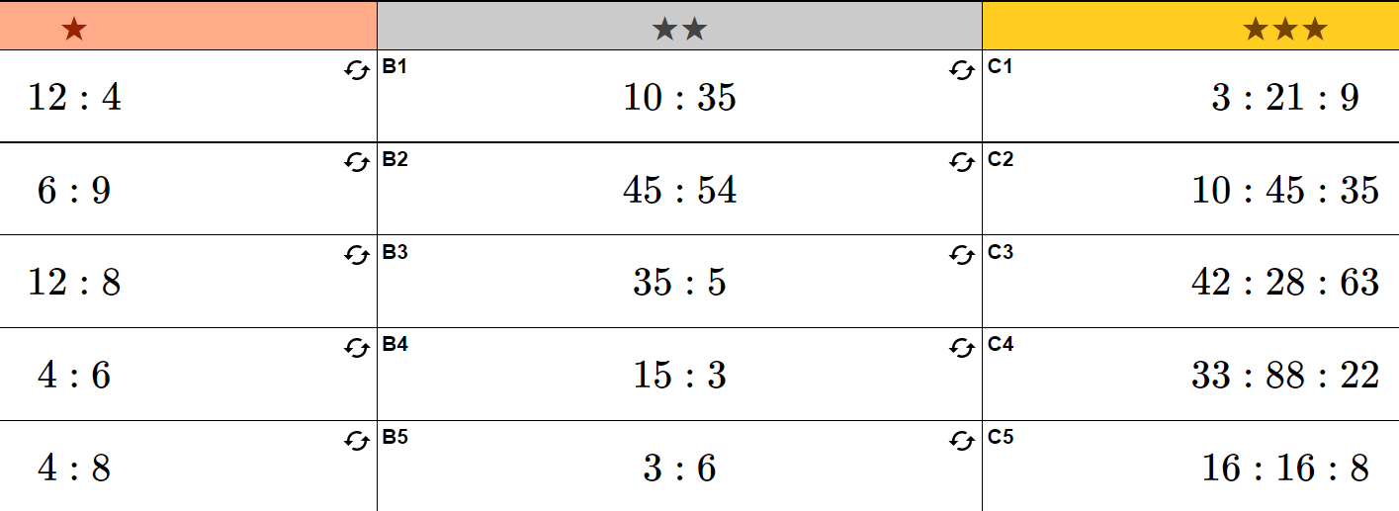

Slide 20
How did you do?
All or almost all answers correct
Most answers correct, some errors
Majority of answers incorrect

Slide 21
Individual practice
Complete “Ratio worksheet”

